Slide 1
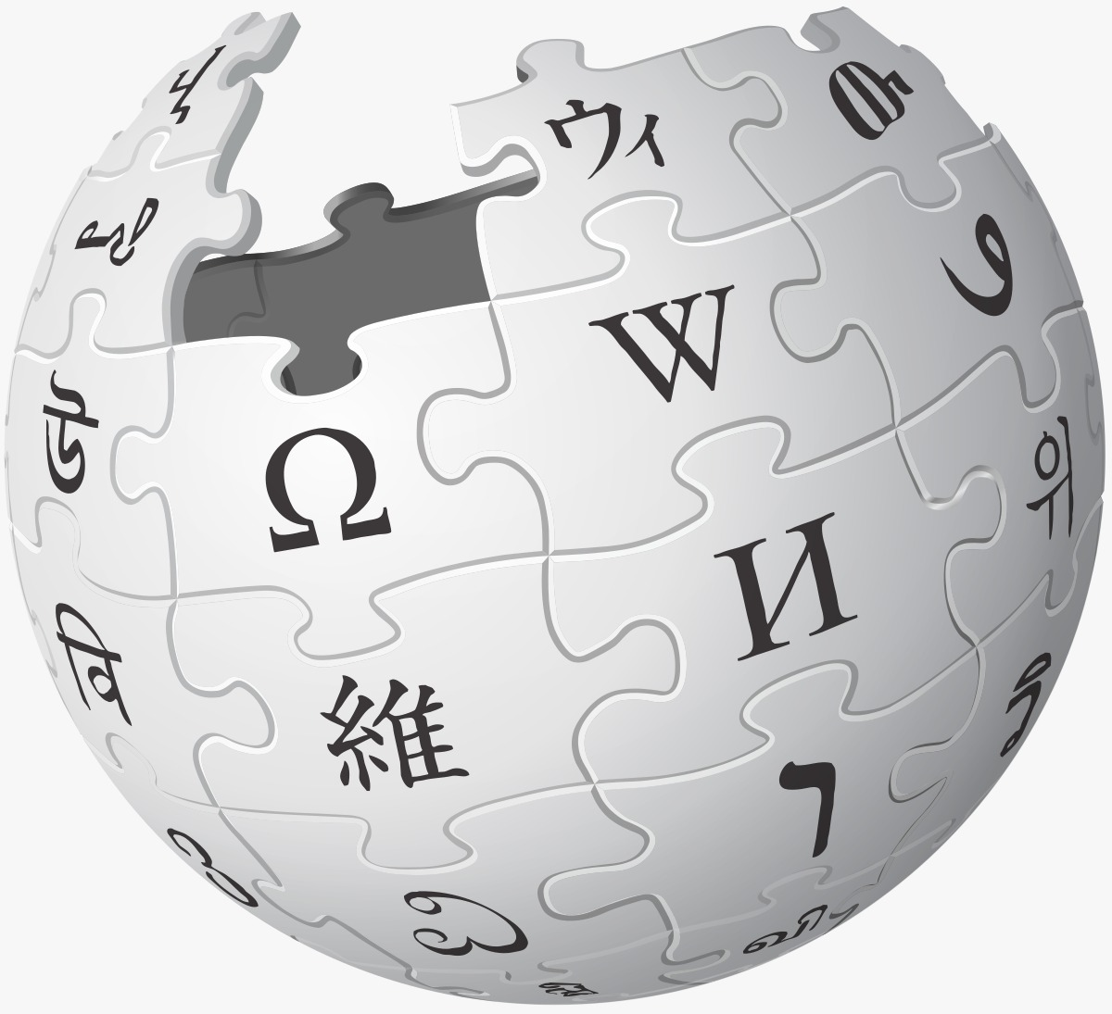
WIKI WOMEN HACKATHON
TEAM MEMBERS – S.SATHEESHNA
A.PRAGNYA
ASMA BEGUM
KRISHNA DURGADEVI
TEAM: IARE-B

Slide 2
INTRODUCTION
PROJECT OVERVIEW:
Problem: It can be difficult to visualize the diversity of women's contributions across Wikipedia.
Solution: To build a data visualization tool that showcases the breadth of women's contributions. This tool could categorize contributions by field, historical period, and other factors, allowing users to explore this data interactively.

Slide 3
motivation
Promoting Awareness: By making women's contributions more visible and accessible through an interactive tool, the project contributes to raising awareness about gender diversity in online platforms.
It benefits both the general public and researchers interested in studying patterns of representation and participation in collaborative knowledge projects like Wikipedia.

Slide 4

PROJECT DESCRIPTION

Slide 5
THE CHALLENGE
Underrepresentation of Women: Women's contributions on Wikipedia often face underrepresentation and lack of visibility, hindering the recognition of their achievements across various fields.
Complexity in Data Understanding: The vastness of Wikipedia data makes it challenging for users to comprehend the extent and diversity of women's contributions, necessitating a tool for simplified exploration.
Addressing Gender Gaps: The project addresses the existing gender gaps in online content by creating a visualization tool that showcases and categorizes women's contributions, encouraging a more equitable representation on the platform.

Slide 6
OUR SOLUTION
Our project aims to build a dynamic data visualization tool using Wikimedia data and tools.
Categorizing contributions by field, historical period, and other relevant factors.
Providing clear visualizations of women's contributions to facilitate exploration of their impact.
Delving into male versus female contributions for insights into gender representation.

Slide 7
KEY FEATURES
Categorization by Field: The project enables users to categorize women's contributions on Wikipedia based on specific fields, providing a focused and organized view of their impact across diverse domains.
Historical Period Exploration: Users can explore contributions over different historical periods, gaining insights into how women's involvement in knowledge creation has evolved over time.
Interactive Exploration: The data visualization tool offers an interactive interface, allowing users to dynamically explore and understand women's contributions, fostering a more engaging and informative user experience.

Slide 8
TECH STACK
Wiki Data- Wiki Data is a free and collaborative knowledge base hosted by the Wikimedia Foundation. It serves as a central repository of structured data to be used by Wikipedia.
SPARQL Queries via Wiki data Query Services- SPARQL queries are crafted and executed using Wiki data Query Services to extract relevant data on women's contributions from Wiki data, providing a structured approach to obtaining information for further analysis.
Power BI –Power BI is employed as the primary visualization tool, creating interactive dashboards that offer a user-friendly interface for exploring and understanding the diverse contributions of women on Wikipedia.

Slide 9
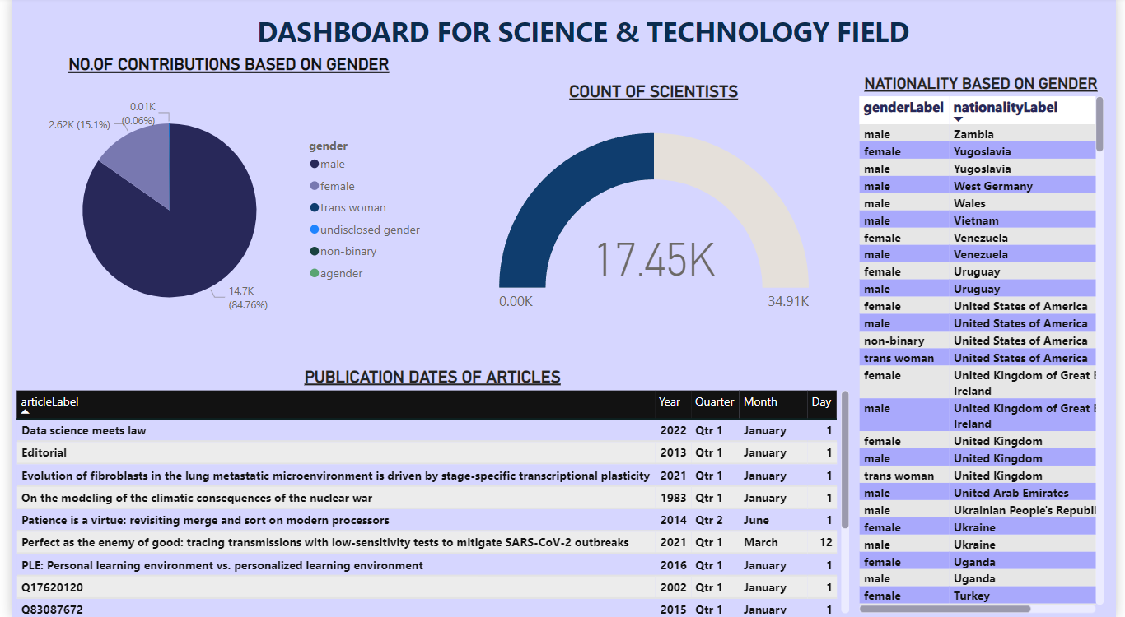
DEMONSTRATION

Slide 10
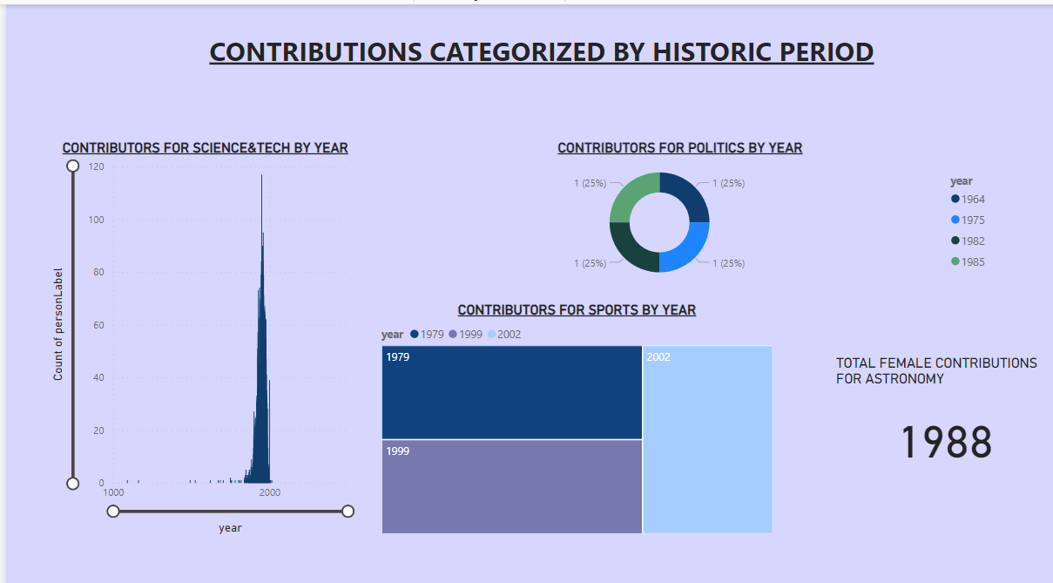

Slide 11
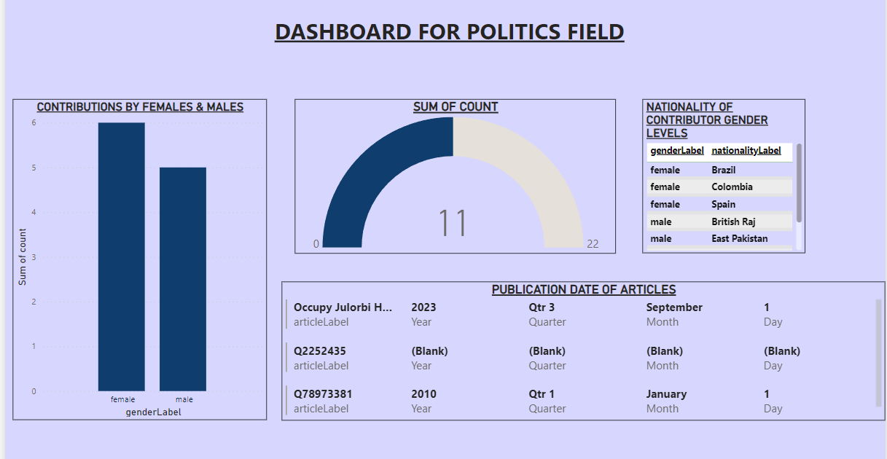

Slide 12
SPARQL QUERIES
SELECT FEMALE CONTRIBUTORS
COUNT OF CONTRIBUTORS
SELECT ?person ?personLabel ?genderLabel
WHERE {
?person wdt:P31 wd:Q5; # Instance of human
wdt:P21 wd:Q6581072; # Female gender
wdt:P106/wdt:P279* wd:Q333. # Field of ASTRONOMY
OPTIONAL { ?person wdt:P21 ?gender. } # Retrieve gender property
SERVICE wikibase:label { bd:serviceParam wikibase:language "[AUTO_LANGUAGE],en". }
}
ORDER BY ?personLabel
SELECT ?genderLabel (COUNT(?gender) as ?count)
WHERE {
?scientist wdt:P31 wd:Q5; # Instance of human
wdt:P106 wd:Q333; # Occupation
wdt:P21 ?gender. # Gender property
SERVICE wikibase:label { bd:serviceParam wikibase:language "[AUTO_LANGUAGE],en". }
}
GROUP BY ?genderLabel

Slide 13
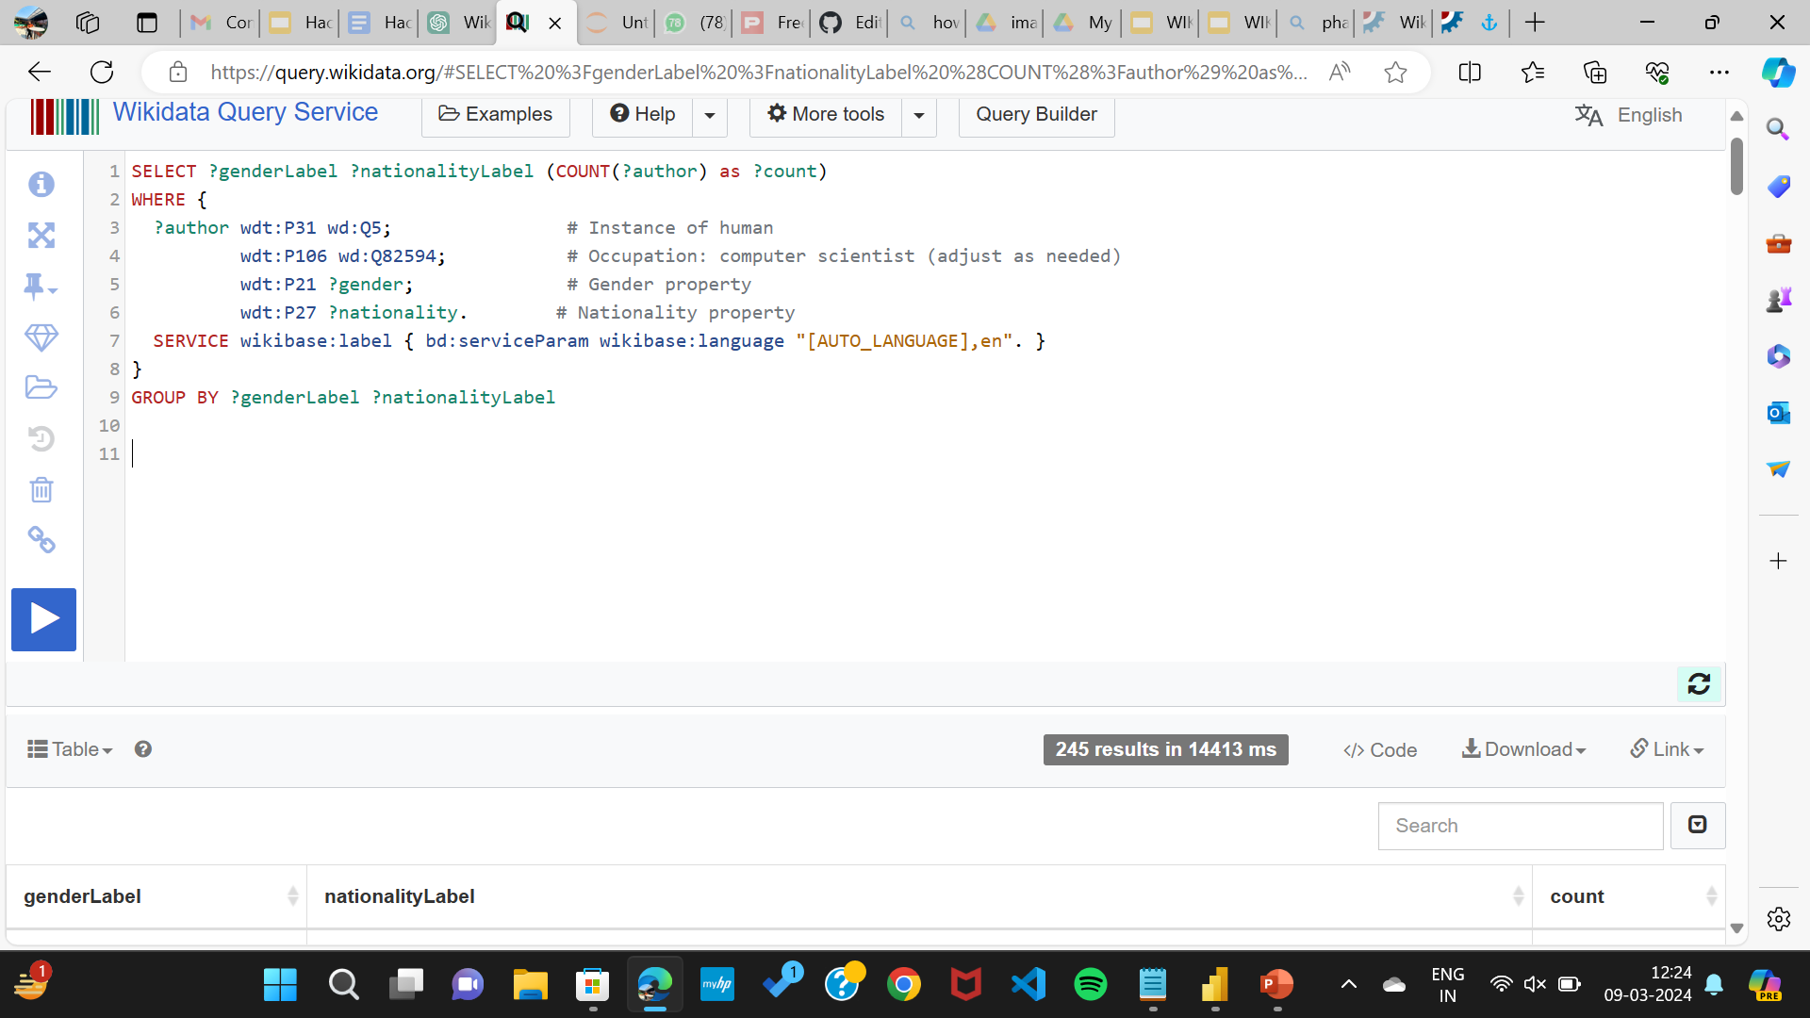

Slide 14
“IMPACT & FUTURE

Slide 15
POTENTIAL IMPACT
Increased Visibility and Recognition: The project aims to amplify the visibility of women's contributions on Wikipedia, potentially leading to increased recognition of their achievements and diverse roles across various fields.
Contribution to Gender Equality: By addressing gender gaps in representation, the project contributes to promoting gender equality in online spaces, fostering a more inclusive and balanced narrative on collaborative platforms like Wikipedia.

Slide 16
FUTURE WORK
Expansion of Data Sources: Integrating additional data sources to enhance the richness and diversity of information, ensuring a more comprehensive representation of women's contributions.
Enhanced Interactivity: Incorporating advanced interactive features, such as personalized & Dynamic user dashboards, collaborative filtering, and more detailed analytics to provide users with a more tailored and engaging exploration experience.

Slide 17
CONCLUSION
In conclusion, our project represents a significant step towards addressing the underrepresentation of women's contributions on Wikipedia. By developing an interactive data visualization tool that categorizes these contributions based on fields and historical periods, we aim to bring attention to the diverse roles women have played in shaping online knowledge. As we look to the future, we envision further enhancements and increased collaboration to improve and expand the impact of our project.

Slide 18

Thank you

